Slide 1


Smart Course Enrollment System
SUMMER INTERNSHIP REVIEW | PYTHON FULL STACK
Lakshana M | 810023205056
Department of Information Technology
University College of Engineering, BIT Campus
Anna University, Tiruchirappalli
IT3711 • Academic Year 2025–2026

Slide 2





Internship at a glance
OVERVIEW
Organization
Astonish InfoTech Private Limited, Tiruchirappalli
Duration
01 June 2026 – 30 June 2026
Domain
Python Full Stack Development
Project
Smart Course Enrollment System (web application)
Focus
FastAPI backend, MySQL database, Jinja2 templates and responsive UI

Slide 3



Company profile | Astonish InfoTech
OVERVIEW
Who they are
Development process
Software development and web solutions company in Tiruchirappalli (Trichy), Tamil Nadu, serving startups, institutions and businesses.
Discuss (requirements) → Design (UI/UX) → Develop (coding, testing) → Deploy (launch, support).
Services offered
Technical domains
Web, software and mobile app development; ERP and CRM solutions; domain and hosting.
AI and ML, Embedded Systems, IoT, VLSI support, Cloud solutions and Cyber Security.

Slide 4
Presentation roadmap
OVERVIEW
01
02
03
04
05
Introduction and internship objectives
Problem identification and proposed solution
System architecture and functional modules
Implementation, database design and algorithms
Output, testing, result analysis, future work and conclusion

Slide 5




Introduction to Python full stack development
INTRODUCTION
A full stack web application that automates course registration for training institutions.
Frontend
Backend
Database
HTML5, CSS3 and JavaScript give a responsive, card-based interface.
FastAPI handles routing, form processing and business logic; Jinja2 renders pages on the server.
MySQL stores categories, courses and enrollments, connected through mysql-connector-python.
Served with Uvicorn; developed in Visual Studio Code.

Slide 6
Objectives of the internship
INTRODUCTION
1
Build a web application using Python, FastAPI, Jinja2, HTML, CSS, JavaScript and MySQL.
2
Design a relational database for categories, courses and enrollment records.
3
Let learners browse categories, view course details and filter by category.
4
Provide an online enrollment form with input validation, plus a login page and dashboard.
5
Reduce paperwork and data entry errors; automate database setup for easy installation.

Slide 7




Problem identification
PROBLEM AND SOLUTION
Manual enrollment
Scattered information
Paper forms re-entered into registers or spreadsheets cause spelling mistakes, duplicates and missing records.
Instructor, duration, level and seats sit in brochures and notice boards that quickly go out of date.
Limited accessibility
Hard to track
Learners can enroll only in office hours, in person or by phone, with no instant confirmation.
Counting applicants per course is manual, and queues build up at the counter during admissions.

Slide 8


Proposed solution
PROBLEM AND SOLUTION
Category browsing and a course catalog showing instructor, duration, level and seats.
A centralized, responsive web platform for categories, courses and enrollment records.
Category filter and an online enrollment form with instant success or error feedback.
Login page and a dashboard with summary figures and the latest enrollment requests.
Tables and sample data are created automatically on first start.

Slide 9



Information managed
PROBLEM AND SOLUTION
Categories
Courses
Enrollments
ID, name, description, icon and colour.
Five sample categories, such as Computer Science and Data Science.
Title, category, instructor, duration, level, description and seats.
Six sample courses linked to categories.
Student name, email, phone, category and course.
Status defaults to Pending; time of submission is recorded.
Data is stored in MySQL and accessed with parameterised SQL queries.

Slide 10
Three-tier system architecture
SYSTEM DESIGN
PRESENTATION LAYER
REQUEST FLOW
Web browser • HTML5 • CSS3 • JavaScript
1 Browser
2 Route handler
3 Validation
4 SQL
5 MySQL
6 Jinja2 template
7 HTML page
8 User
BUSINESS LOGIC LAYER
FastAPI • Jinja2 templates • Uvicorn server
DATABASE LAYER
MySQL • categories, courses, enrollments

Slide 11
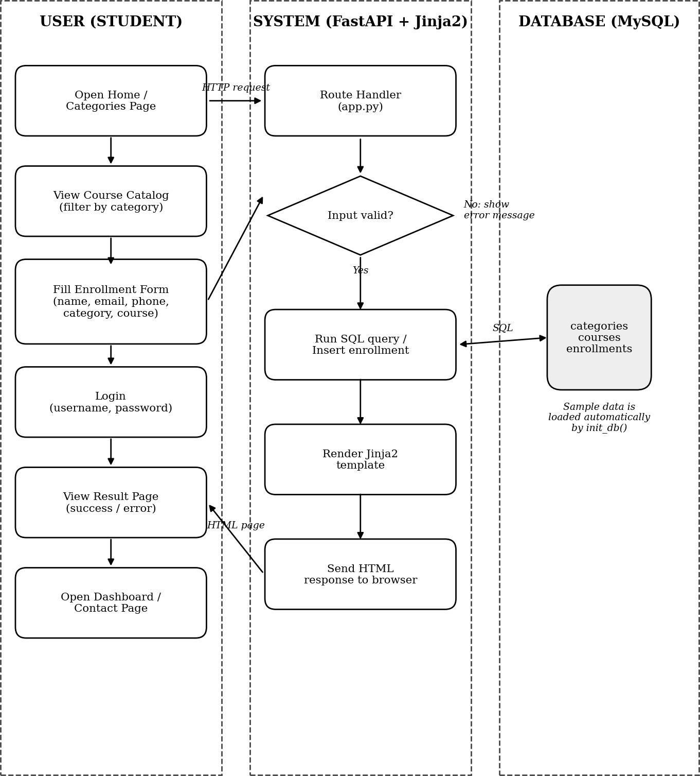
Block diagram
SYSTEM DESIGN
The learner opens pages, views courses and submits the enrollment form.
1
A FastAPI route handler receives each request and validates the input.
2
A SQL query reads from or inserts into MySQL.
3
A Jinja2 template is rendered and the HTML page is returned to the browser.
4

Slide 12
Functional modules
SYSTEM DESIGN
01
Home and categories
02
Course catalog
Platform introduction, statistics and category cards with Open category links.
Course details from a JOIN query, with a category filter dropdown.
03
Online enrollment
04
Login and dashboard
Form with validation; saves the request with status Pending.
Input validation and redirect; summary cards, courses and latest enrollments.

Slide 13



Implementation and development
IMPLEMENTATION
Common stylesheet with CSS variables, gradient background, navigation bar, cards and forms.
FastAPI project structure with static files and Jinja2 templates mounted.
init_db creates tables, adds missing columns and loads sample data on first run.
fetch_all helper runs parameterised queries using dictionary cursors.
Routes built for categories, courses, enrollment, login, dashboard and contact.

Slide 14
Database setup and tables
IMPLEMENTATION
categories and courses
enrollments
CREATE TABLE IF NOT EXISTS categories (
id INT AUTO_INCREMENT PRIMARY KEY,
name VARCHAR(100) NOT NULL UNIQUE,
description TEXT, image VARCHAR(100),
color VARCHAR(30)
);
CREATE TABLE IF NOT EXISTS courses (
id INT AUTO_INCREMENT PRIMARY KEY,
title VARCHAR(150) NOT NULL,
category_id INT NOT NULL,
instructor VARCHAR(100),
duration VARCHAR(50),
level VARCHAR(50), description TEXT,
seats INT DEFAULT 50,
FOREIGN KEY (category_id)
REFERENCES categories(id)
);
CREATE TABLE IF NOT EXISTS enrollments (
id INT AUTO_INCREMENT PRIMARY KEY,
student_name VARCHAR(100) NOT NULL,
student_email VARCHAR(100) NOT NULL,
course_name VARCHAR(150) NOT NULL,
category_name VARCHAR(100),
phone VARCHAR(30),
status VARCHAR(30) DEFAULT 'Pending',
created_at TIMESTAMP
DEFAULT CURRENT_TIMESTAMP
);
One-to-many relationship: one category has many courses (foreign key).

Slide 15
Backend code | Filter and enrollment
IMPLEMENTATION
Course catalog with category filter
Enrollment insert
query = """
SELECT c.*, cat.name AS category_name
FROM courses c
JOIN categories cat
ON c.category_id = cat.id
"""
params = ()
if selected_category:
query += " WHERE cat.name = %s"
params = (selected_category,)
query += " ORDER BY c.id"
cursor.execute("""
INSERT INTO enrollments
(student_name, student_email,
course_name, category_name,
phone)
VALUES (%s, %s, %s, %s, %s)
""", (student_name, student_email,
course_name, category_name,
phone))
Values are passed as parameters, which protects against SQL injection.

Slide 16



Algorithms | Core workflows
IMPLEMENTATION
Enrollment
Course filter
Load dropdowns → enter details → browser checks fields → POST → insert row → show success or error.
Read category from query string → JOIN courses and categories → add WHERE if selected → render list.
User login
Initialisation and dashboard
Read and trim input → reject empty fields or password under 4 characters → HTTP 303 redirect to dashboard.
Create tables, add missing columns, seed empty tables. Dashboard counts records and reads the latest eight enrollments.

Slide 17
Testing parameters
TESTING AND RESULTS
Browse categories and filter the course catalog by category.
Submit enrollments and confirm records are stored in MySQL.
Validate empty fields, invalid email format and short passwords.
Check login redirect, dashboard figures and automatic database initialisation.
Test behaviour when the database is not running; check layout on smaller screens.

Slide 18




Result analysis
TESTING AND RESULTS
All modules behaved as expected under normal and edge-case inputs.
Pages loaded quickly because queries are simple and sample data is small.
The card-based interface adapted well to different screen sizes.
Course information is in one place and enrollment takes a single form.
Staff see the latest enrollments immediately on the dashboard; no numeric benchmarks were reported.

Slide 19
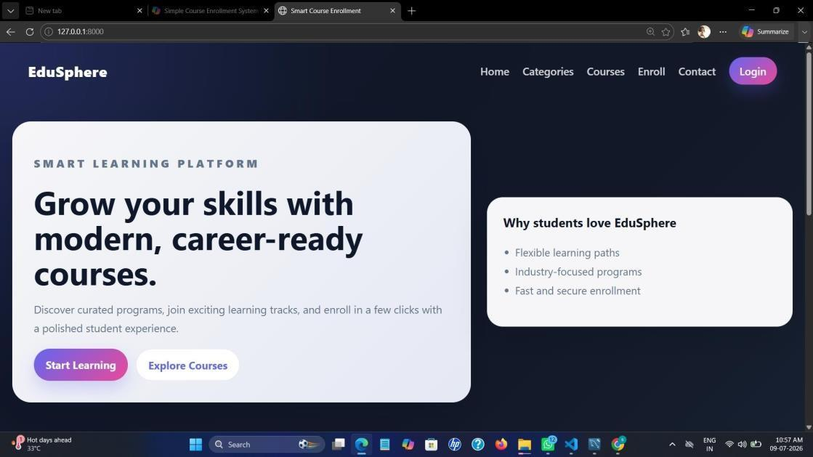
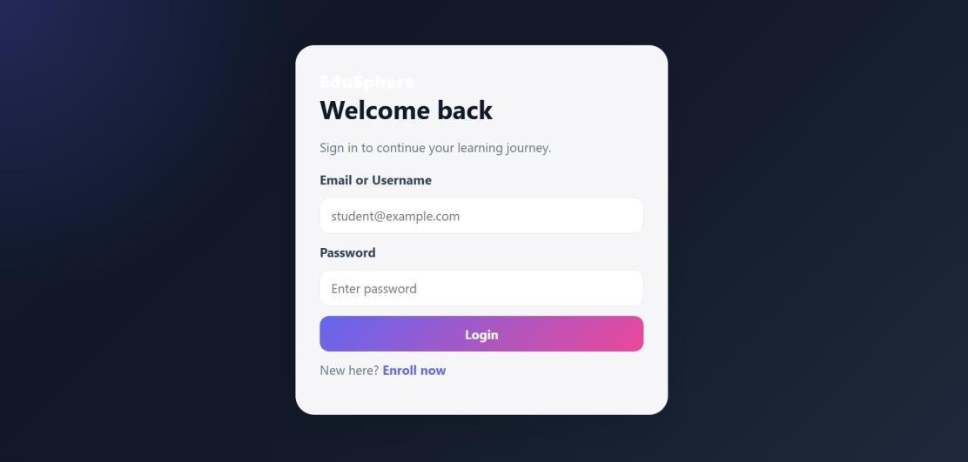
Output screenshots | 1
TESTING AND RESULTS
Home page
Login page

Slide 20
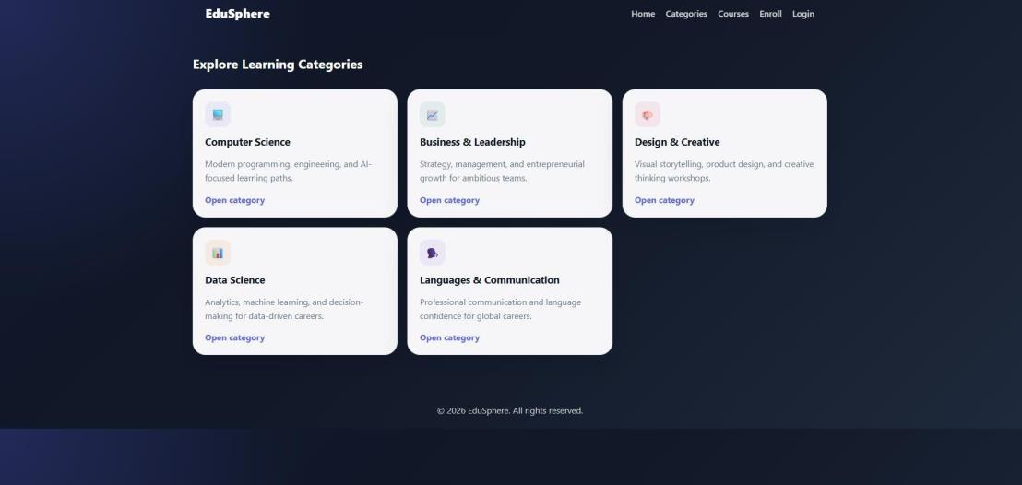
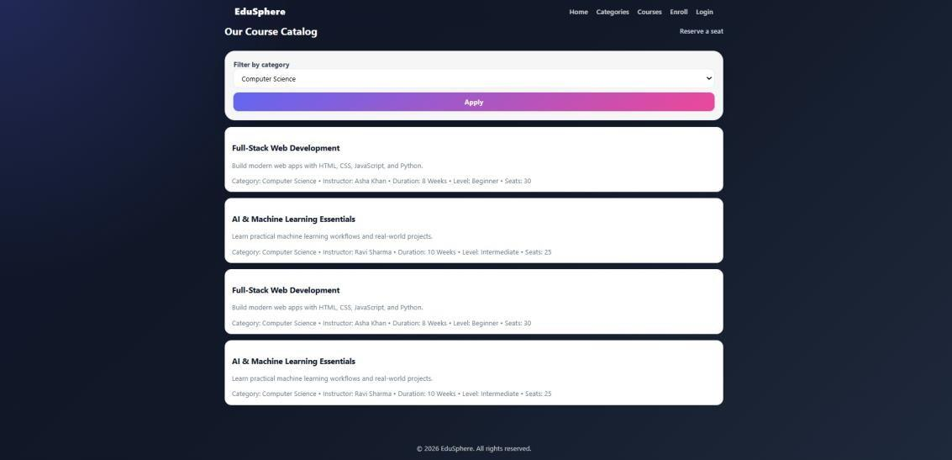
Output screenshots | 2
TESTING AND RESULTS
Learning categories
Course catalog with category filter

Slide 21
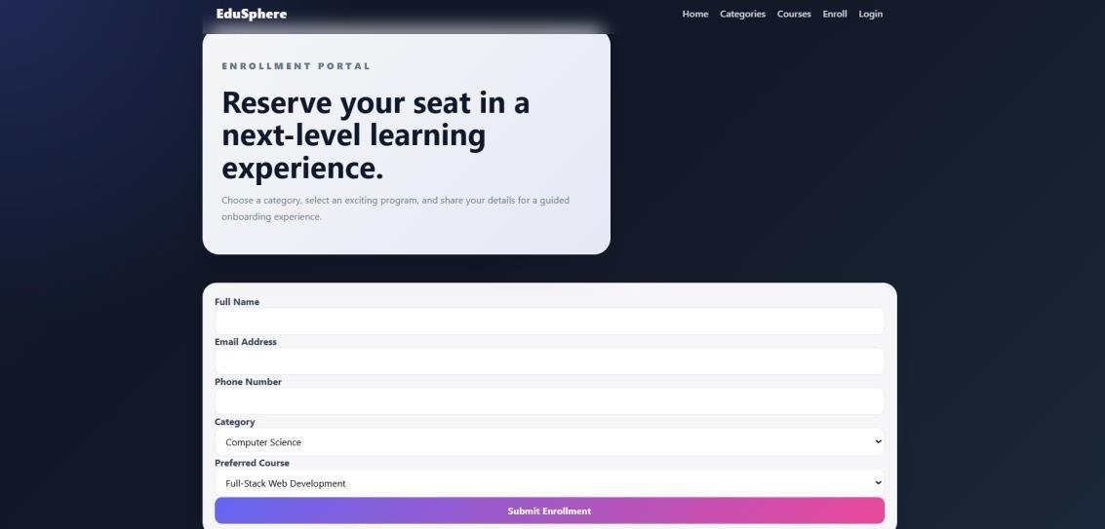
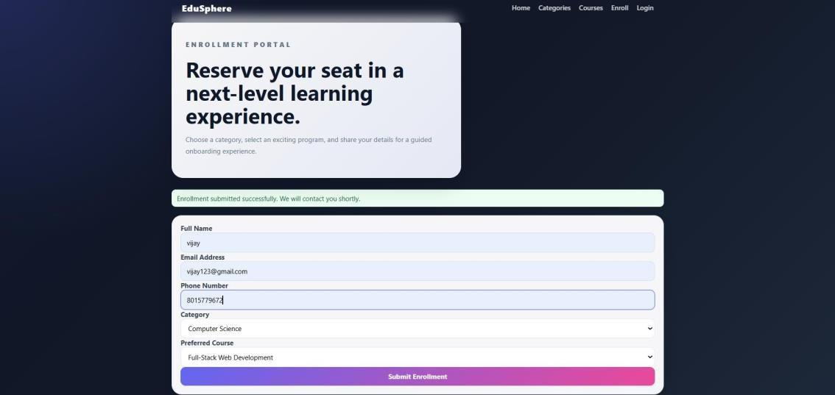
Output screenshots | 3
TESTING AND RESULTS
Enrollment form
Enrollment submitted successfully

Slide 22


Observations | Areas to improve
REVIEW AND CONCLUSION
Duplicate sample courses
Login is validation only
Each course appeared twice because sample data was loaded by both the SQL script and the setup code.
Credentials are not checked against stored accounts yet.
Seats and dropdowns
Credentials in code
Seat count is not reduced after enrollment; any course can be picked with any category.
Database user and password sit in the source file and should move to environment variables.

Slide 23





Future work
REVIEW AND CONCLUSION
Secure login with password hashing, sessions or JWT, and role-based access.
Administrator panel to manage courses and approve or reject enrollments.
Seat management with a waiting list; duplicate enrollment prevention.
Email and SMS notifications; payment gateway integration.
Search, pagination, analytics reports, automated tests and Docker/cloud deployment.

Slide 24

Conclusion and key learning
REVIEW AND CONCLUSION
Replaced manual, paper-based enrollment with a centralized digital platform.
Delivered category browsing, a filtered course catalog, online enrollment, login and a dashboard.
Gained practical skills in FastAPI, SQL and MySQL, form handling and responsive UI design.
Thank you
Understood the full software development life cycle in an industry setting.

